Slide 1
Team 1: Gen AI Hackathon 2025
Deck

Slide 2
Business Problem Statement
Frequent Ad-Hoc Data Requests: Multiple teams often submit ad-hoc data requests that require immediate attention, creating a bottleneck in data retrieval processes and diverting focus from core responsibilities.
Repetitive Nature of Requests: Many requests are similar, differing only in specific segments or filters, leading to redundant query execution and inefficient use of resources.
Time-Consuming and Resource-Intensive: Crafting, running, and formatting queries for each request takes significant time, delaying responses and impacting the team's ability to focus on strategic tasks.
Hindrance to Core Work and Decision-Making: Addressing these requests disrupts primary work priorities and delays the delivery of insights critical for timely, data-driven decision-making.
Why Use Gen-AI ?
Automation and Efficiency: Generative AI can automate repetitive tasks such as query generation, data formatting, and report creation by understanding natural language inputs. This reduces manual intervention, speeds up response times, and ensures consistency in handling frequent and similar ad-hoc data requests.
Scalability and Self-Service Capabilities: Gen-AI enables the creation of self-service tools ( Agents ) that empower teams to retrieve data on their own by simply describing their requirements in natural language. This minimizes the dependency on the analytics team, freeing them to focus on high-priority tasks and strategic projects.
Data as of 30/12/2024

Slide 3
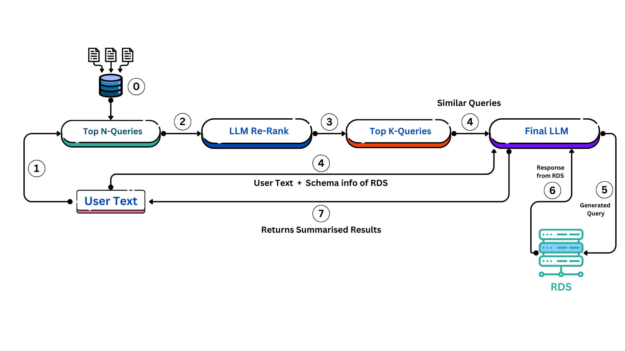
Our Approach & Architecture
Optimized Steps for Query Resolution:
Step 0 : Store General Queries : Save 20-30 commonly used queries in a Vector Database (Vector-DB).
Step 1 : Retrieve Relevant Queries : User inputs a query, and the system fetches the top-N relevant queries from the Vector-DB.
Step 2 : Re-Rank Queries : An LLM re-ranks the fetched queries based on similarity scores.
Step 3 : Select Top Queries : Extract the top-K queries from the ranked list.
Step 4 : Generating Query : LLM takes the user requirements, schema of the DB and top K similar queries, then generates the required query.
Step 5 & 6 : Execute Query : We use the generated Query to fetch the data from RDS.
Step 7 : Deliver Results : LLM returns the data along with a summarized report.
Data as of 30/12/2024

Slide 4

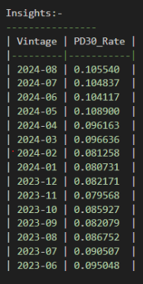
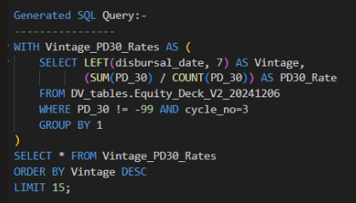
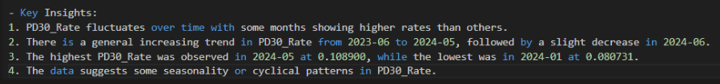
Architecture Solution Example 1
Step 1
Steps 2 - 6
Step 7
Data as of 30/12/2024

Slide 5

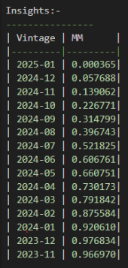
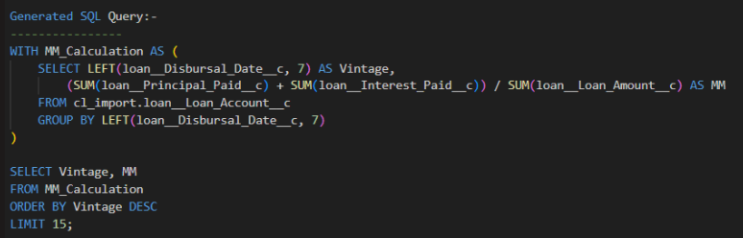

Architecture Solution Example 2
Step 1
Step 7
Steps 2 - 6
Data as of 30/12/2024

Slide 6

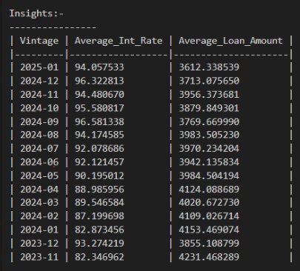
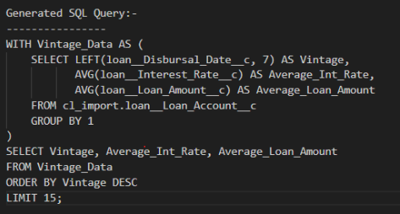
Architecture Solution Example 3
Step 1
Steps 2 - 6
Step 7
Data as of 30/12/2024

Slide 7

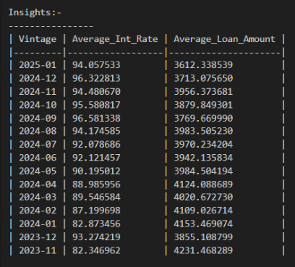
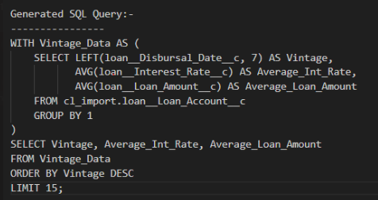
Architecture Solution Example 4
Step 1
Step 7
Steps 2 - 6
Data as of 30/12/2024

Slide 8

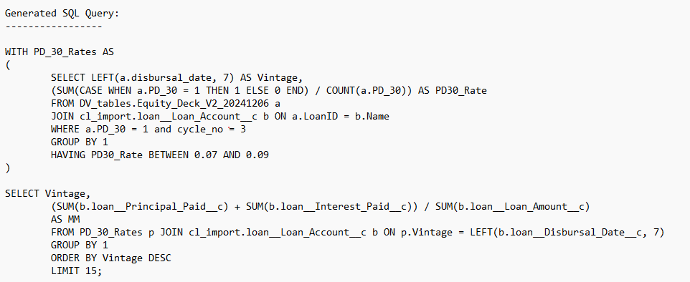
Complex Solution Example
The main objective of this Gen-Ai process is to generate data/reports that may be challenging for the BI team to produce directly. For instance, our system effectively calculates performance for specific segments, such as vintages with 3PD30 rates are within a particular range ( 7% and 9% ).
User Query
Correct Query Generated by System
Data as of 30/12/2024

Slide 9
Impact on Business
Faster Analysis: This tool enables rapid generation of requested analyses, saving time and effort compared to traditional methods.
Ease of Use: Users can perform complex data analyses without requiring advanced SQL knowledge.
Improved Decision-Making: As many business decisions revolve around fundamental data analyses, this tool accelerates the process, enabling quicker and more informed decision-making.
Feature Improvements and Challenges:
Handling Feedback for Complex analysis:
Enhance the architecture to manage more complex user inputs and assist with intricate analyses.
Build capabilities for multi-turn interactions to refine and adapt queries based on evolving feedback.
Agent-Based Assistance & Fine-Tuning of LLM’s:
Experiment with advanced AI agents to mimic human-like performance.
Improve the accuracy of generated SQL queries w.r.t to our database ( With more fine tuning ).
Adoption of Open-Source Models:
Initially utilized a 3B parameter-based Llama 3.2 model due to space constraints, which provided reasonable performance.
Highlighted potential to achieve OpenAI-level performance with open-source models like Hugging Face or Llama, particularly when deployed on a 64 GB instance.
Opportunity to significantly reduce costs while maintaining or enhancing performance.
Data as of 30/12/2024

Slide 10
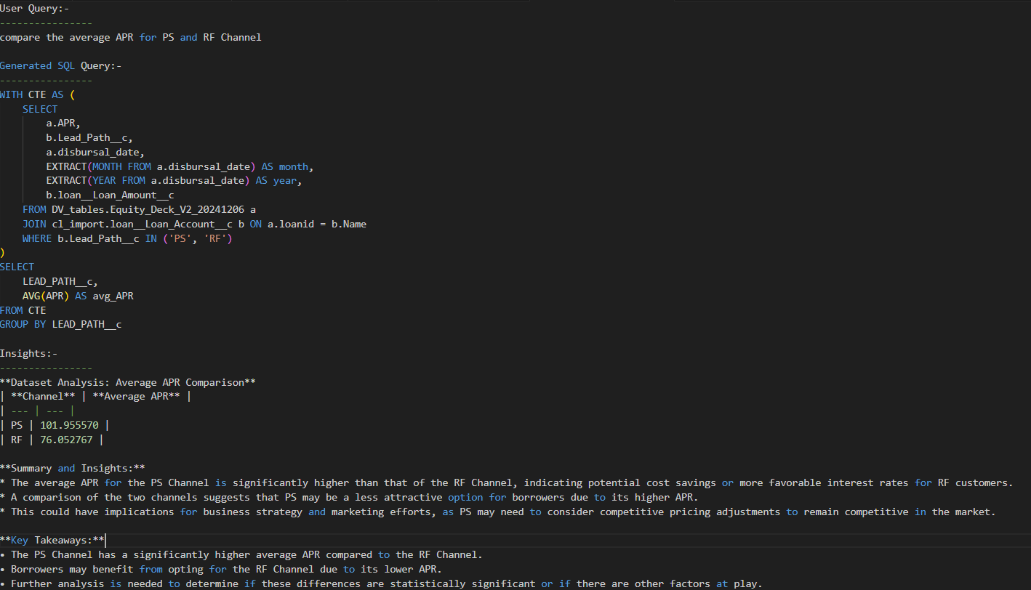
Exploring Free-to-Use Open-Source LLMs:
We leverage the latest open-source Llama 3.2 models, which are free to use. Even the smaller 3B model demonstrated performance comparable to the GPT-3.5 Turbo 8B model during testing.
By adopting a slightly larger version of the Llama model, we can achieve similar results for the task with minimal to no LLM model costs.
Below is the output generated by the Llama 3.2:3B-Instruct-Q8_0 model
Data as of 30/12/2024

Slide 11
Thank You
Data as of 30/12/2024

